Slide 1
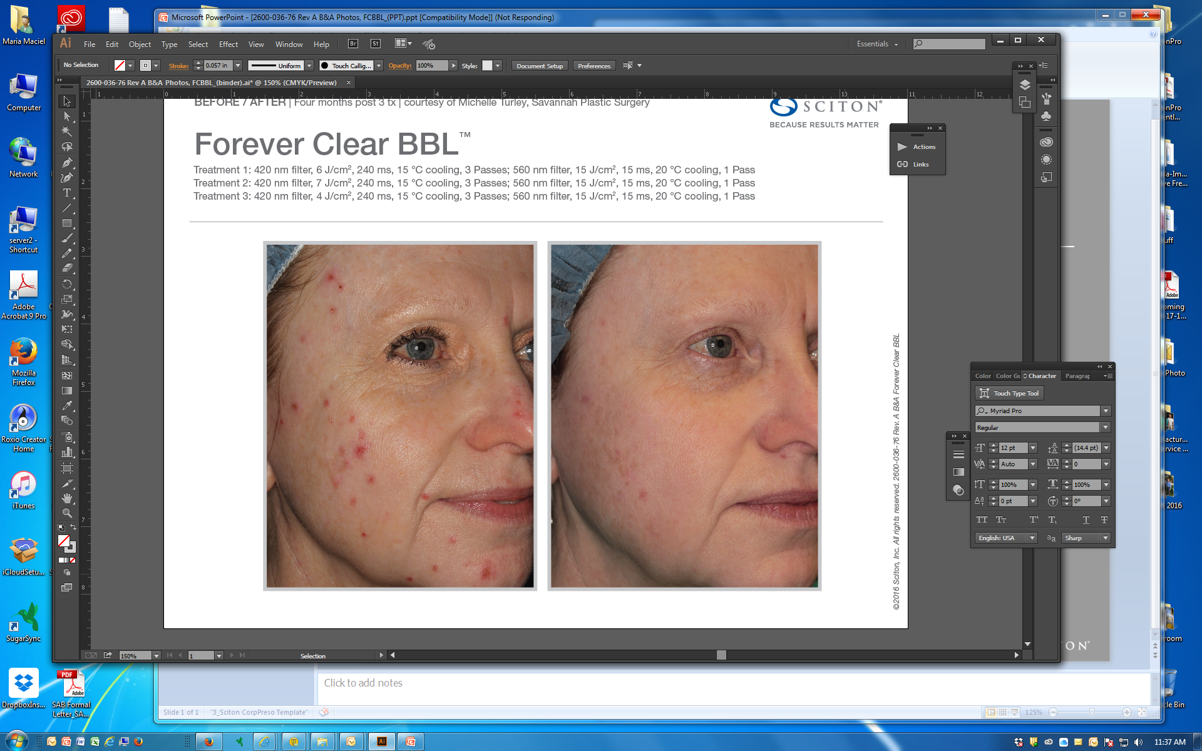
BEFORE / AFTER | Four months post 3 tx | courtesy of Michelle Turley, Savannah Plastic Surgery
Forever Clear BBL™
Treament 1: 420 nm filter, 6 J/cm², 240 ms, 15 °C cooling, 3 Passes; 560 nm filter, 15 J/cm², 15 ms, 20 °C cooling, 1 Pass
Treatment 2: 420 nm filter, 7 J/cm², 240 ms, 15 °C cooling, 3 Passes; 560 nm filter, 15 J/cm², 15 ms, 20 °C cooling, 1 Pass
Treatment 3: 420 nm filter, 4 J/cm², 240 ms, 15 °C cooling, 3 Passes; 560 nm filter, 15 J/cm², 15 ms, 20 °C cooling, 1 Pass
©2016 Sciton, Inc. All rights reserved. 2600-036-76 Rev. A B&A FCBBL

